Slide 1
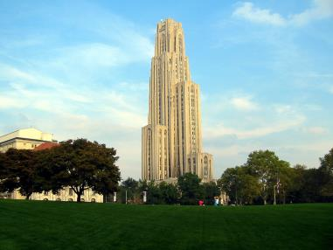
Final Presentation
Team #2 - NOT YET
2016.06.24

Slide 2
Table of contents
1. Overview of programmatic aspects
About Team #2 – NOT YET
Schedule
Time Logs
Configuration Management
2. Overview of the architectural design
Context Diagram and Influential Architecture Drivers
Design decisions and alternatives
Architecture in static, dynamic, physical perspective
3. Test
Test case
Verification, Validation
4. Lessons learned & Q/A
Lessons learned
Q/A

Slide 3
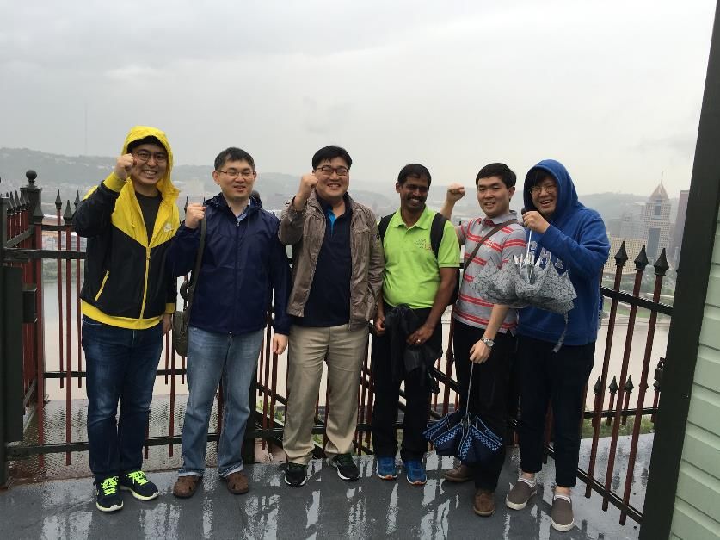
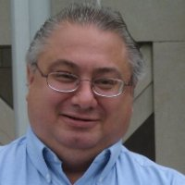
Team members – NOT YET

Slide 4
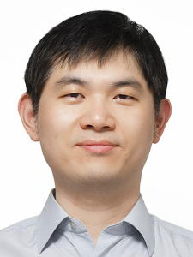

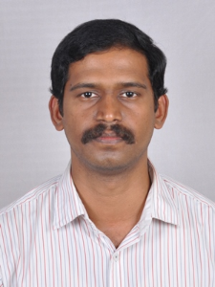
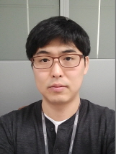
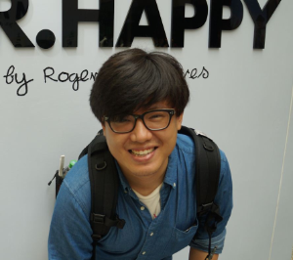
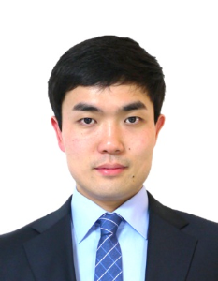

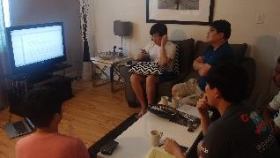
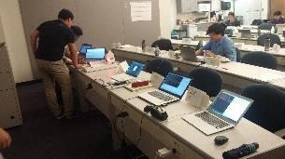
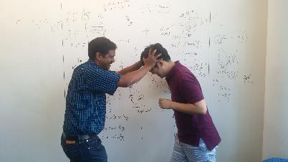
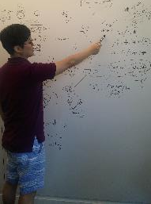
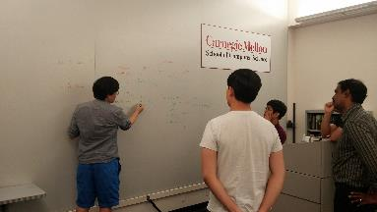
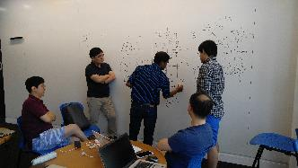
Team members – NOT YET
Daniel Plakosh | Sunghoon Yun | Sangjun Lee | Gladvin Chinnadurai | Byounghoon Kim | Wonhong Kwon | Gunwoo Kim | Hidden Memeber

Slide 5
Organization and roles
 | Team Mentor
 | Daniel Plakosh
 | Team Leader
 | Sunghoon Yun
 | Chief Architect
 | Wonhong Kwon
 | Lead Engineer. (Server)
 | Gunwoo Kim
 | Lead Engineer (Protocol)
 | Byounghoon Kim
 | Lead Engineer (Facility)
 | Sangjun Lee
 | Lead Engineer. (Owner)
 | Gladvin Chinnadurai
Title | Role Assignment | Deliveries | Common Job
Team Leader | Project Management | WBS, Schedule , Agile Sprint | Planning. Architectural Discussion. Test.
Chief Architect | Architectural Design | ADS, Architecture documents.
Lead Engineer(Protocol) | Communication design. Driver Application | Comm library. Driver App source.
Lead Engineer(Facility) | Facility control and user interface | Facility and kiosk source.
Lead Engineer(Server) | Server logic and redundancy. Pub/Sub Pattern implementation. | Server and arbiter source.
Lead Engineer(Owner) | Owner business logic design - statistics | Owner and statistics source.

Slide 6
Schedule
We used agile style development process.
We made 4 sprint . Each sprint has own iteration of working categories.
Jun 1W
Jun 2W
Jun 3W
Jun 4W
Sprint 1
Sprint 2
Sprint 3
Sprint 4
Plan
Sprint 1, 2 Plan
Mentor meeting
Sprint 3 Plan
Mentor meeting
Risk Mitigation meeting
Sprint 4 Plan
Mentor meeting
Mentor meeting
Analysis
Use case
Context diagram
QA refine
FR refine
QA refine
Use case
Context diagram
QA refine
Experiment
MQTT Server/Client
Arduino control
Arduino USB communication
Server DB
MQTT Security
MQTT Server/Client
Arduino control
Design
Research architectural Pattern
Start View , MQTT Topic,
DB Schema Design
Research architectural Pattern
Research Tatic
Start detail design
Research architectural Pattern
Implementation
PC environment setup
Git Hub setup
Server (communication,
redundancy, DB)
Server logic
Driver, Owner, Attendant,
Facility, Kiosk Application
Server logic
Driver, Owner, Attendant,
Facility, Kiosk Application
Testing
Sprint2 result test
System test (16 test case)
System test (31 test case)
Documentation
Start Time log, ADS
Planning v1.0
Sprint and Time logs v1.0
Failure model list v1.0
System test case v1.0
System test case v1.1
Final Presentation v1.0

Slide 7
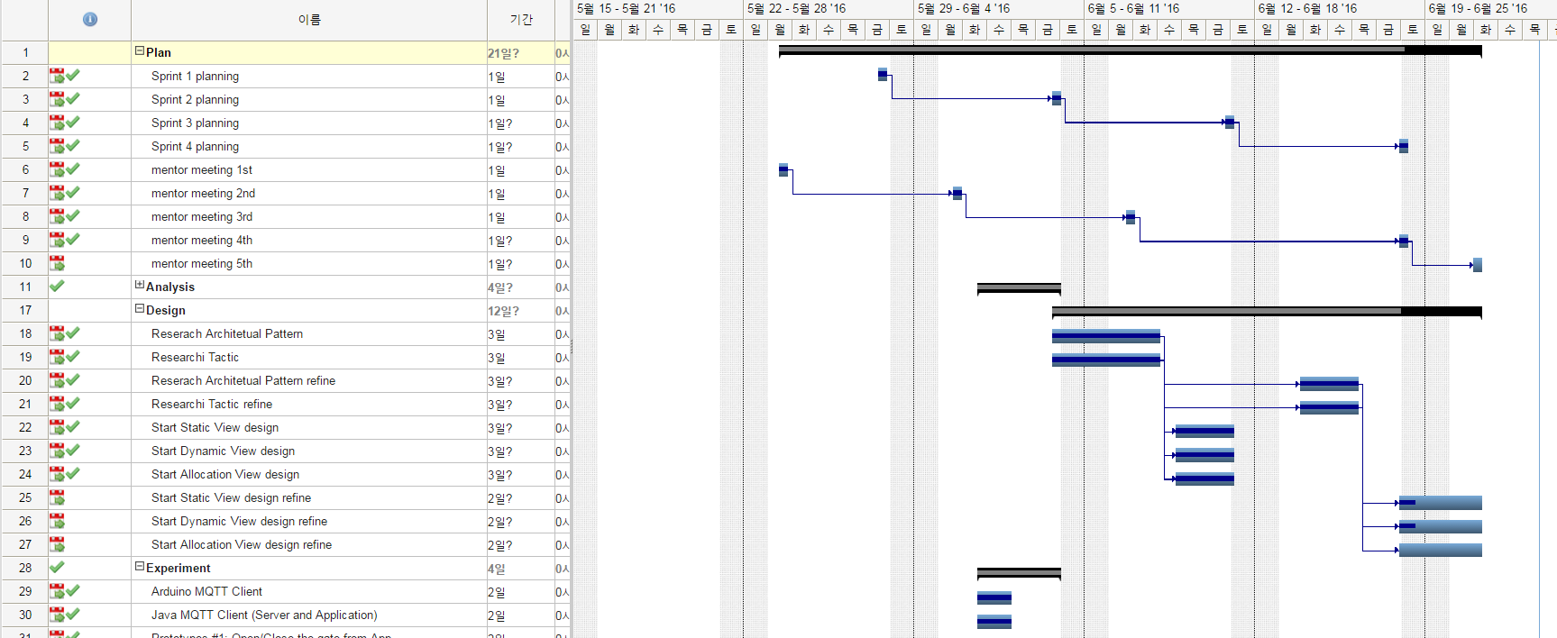
Schedule
Estimated backlogs are used to make a refined WBS Plan.
New WBS is made using Gant Chart.
We had tracking project by the chart.
This is full version of WBS.
You need chrom plug-in (gantter tool)

Slide 8
Time logs - 1
We had estimated the total time as 576 hours using a simple equation.
6 (people) x 24 (working day) x 4 (working time/day) .
We had made a initial version of WBS that have 53 items for the project and split work load as table
Category | Hours | Load (%)
Plan | 56 | 10
Analysis | 120 | 20
Design | 150 | 26
Implementation | 130 | 24
Testing | 120 | 20
Total | 576 | 100

Slide 9
Time logs - 2
In actual project, we used agile style development process and added two more categories.
We made backlogs every week for next sprint and estimated working time with the logs.
The result is as below.
 | sprint1 | sprint2 | sprint3 | sprint4 | total
Plan | 9 | 8 | 8 | 6 | 31
Analysis | 38 | 6 | 0 | 0 | 44
Experiment | 36 | 14 | 0 | 0 | 50
Design | 40 | 59 | 4 | 9 | 112
Implementation | 4 | 10 | 162 | 52 | 228
Test |  | 2 | 2 | 4 | 8
documentation | 14 | 24 | 16 | 40 | 94
Total |  |  |  |  | 567
 | sprint1 | sprint2 | sprint3 | sprint4 | total
Plan | 28.6 | 7 | 18 | 6 | 59.6
Analysis | 35.5 | 3 | 0 | 0 | 38.5
Experiment | 31 | 7 | 10 | 0 | 48
Design | 34.8 | 54.5 | 30 | 8 | 127.3
Implementation | 3 | 42 | 109 | 61 | 215
Test |  | 6 | 4 | 9 | 19
documentation | 6.2 | 19 | 31 | 57 | 113.2
Total |  |  |  |  | 620.6

Slide 10
Time logs - 3
Plan and Design work load estimation is similar between initial and actual used but others are very different.
Sprint estimation and actual used time graphs are almost matched.

Slide 11
Configuration Management
Managed Artifacts & Tools
Documents (Google Drive & GitHub.com)
Database Schema (GitHub.com)
Source Code & Issues (GitHub.com)
Artifacts baselining & pre-condition
Documents (After review meeting)
Database Schema (After peer review. Schema and sample data)
Source Code (After sub feature is in working condition)
Information Propagation
Hangout Group
Sync up meetings (After lunch and before leaving to rooms)

Slide 12
System Context Diagram
Driver’s Information
Sure-Park System
Driver
Status
Attendant
Product Developer
Add algorithm
Statistics
Owner
Configure
System Operator
Credit Card Information
Credit Card Payment System
Parking Facility
Sensor Data
Control
System Boundary
A
B
Control flow from A to B
System
A
B
Data flow from A to B
A
B
A interact with B
External Entity

Slide 13
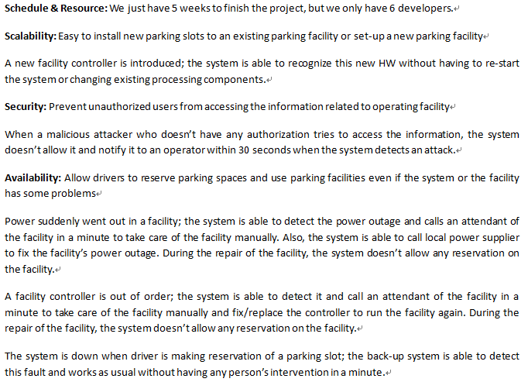
Influential architecture drivers

Slide 14
Architecture Design – 1st Decomposition (dynamic perspective)
Facility
Controller
Sure-Park
Service System
Process
A
B
Data flow from A to B

Slide 15
Architecture Design – Patterns for high-level architecture (dynamic perspective)
Main Server
Publisher
Publisher
Local Server
Local Server
Pub/Sub
Event Bus
Subscriber
Subscriber
Client
Client
Client
Client
Client
Client
Process
A
B
Data flow from A to B

Slide 16
Architecture Design – 2nd Decomposition (dynamic perspective)
Pub/Sub
Event Bus
Facility
User I/F
Facility Controller
Facility
Manager
Sure-Park
Reservation
System
Sure-Park
Processing
System
Sure-Park
Statistics
Viewer
Sure-Park
Manager
Data Repository
Process
A
B
Data flow from A to B

Slide 17
Architecture Design – Tactic #1: Ping/Echo (dynamic perspective)
Facility Controller
PING
Pub/Sub
Event Bus
ECHO
Sure-Park
Processing
System
ECHO
PING
Process
A
B
Data flow from A to B

Slide 18
Architecture Design – Tactic #2: Passive Redundancy (dynamic perspective)
Sure-Park
Processing
System
Pub/Sub
Event Bus
Sure-Park
Processing
System
Process
Process running on the server
Data Repository
Wireless Network Connection

Slide 19
Architecture Design – Relief the negative effects of ping/echo tactic
Ping/Echo
Modifiability
(Add to system)
Security
(Ping flood)
Performance overhead
Detect service denial
Cost
Modifiability
(Add to system)
Tactic
Tradeoffs

Slide 20
Architecture Design – Dynamic Perspective
Facility
User I/F
Facility Controller
MQTT Broker (Mosquitto)
Facility
Manager
Sure-Park
Statistics
Viewer
Sure-Park
Manager
Sure-Park Reservation
System
Sure-Park
Processing
System
CCPS
A
B
Register to listen for event
Communication Manager (Thread)
A
B
Message flow
Java method call
Thread
Process
A
B
Data flow
Callback
Database
External Entity

Slide 21
Architecture Design – Communication Manager (dynamic perspective)
Client Channel
Component
Server Channel
MQTT
Broker
Publish Channel
Subscribe Channel
Data Flow
Thread
Object
Process

Slide 22
Architecture Design – Static Perspective
User Interface
UI Layer
Reservation
Facility Status
Statistics
Security and Account
Facility Control
Business Logic Layer
Communication Manager
Framework Abstraction
DB Manager
Arduino Communication Wrapper
Abstraction Layer
Paho
(MQTT Lib.)
Credit Card Proxy
Vert.x Framework
pubsub
client
Arduino Framework
Framework
Layer
Layer
3rd Party
A
B
A uses B
Module
Database

Slide 23
Architecture Design – Static Perspective
Business Logic Layer
Sure-Park
Statistics
Viewer
Sure-Park
Manager
Facility
Manager
Sure-Park
Reservation
System
Sure-Park
Processing
System
Facility
User I/F
Facility
Controller
Abstraction Layer
Communication Manager
DB Manager
Arduino Communication Wrapper
Framework Layer
Paho MQTT Library
Credit Card Proxy
Vert.x Framework
pubsub
client
Arduino Framework
Layer
3rd Party
A
B
A uses B
Module
Database

Slide 24

Architecture Design – Physical Perspective
Kiosk
Arduino (Main)
Arduino (Sub)
Facility
User I/F
Facility
Controller
Facility
Controller
MQTT Broker
Sure-Park Processing System
1
0..*
Facility Manager
1
Wi-Fi Router
Firewall
Firewall
Ethernet Router
Public Internet
Sure-Park
Manager
Private Network
Sure-Park Reservation System
Sure-Park Processing System
Sure-Park Statistics Viewer
A
DB on a server
Network Equipment
B
A
SW ‘A’ running on a machine ‘B’
USB Connection
Cloud Environment
A
SW ‘A’ running on a server machine
802.11 Wi-Fi
Ethernet
Parking Facility
A
SW ‘A’ running on a user machine

Slide 25
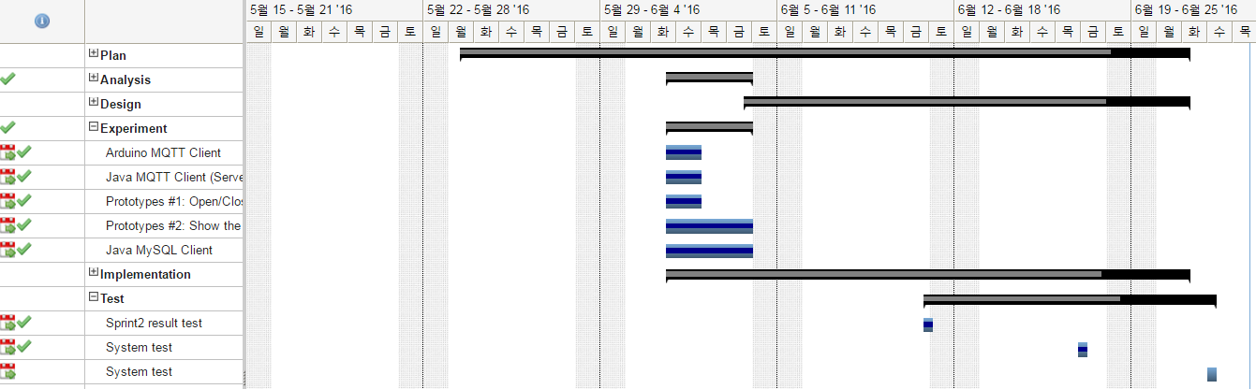
Test , Verification, and Validation
We had experiments before implementation
We had test the system end of every sprint.

Slide 26
Test Cases
We made test cases
WBS |  | Description | Number |  | precondition | Testing Sequence | Expected Results
L1 | L2
Server | Server (switching function - Redundancy) | If primary server is unavailibe because of power down or network trouble, secondary server should work within guaratted time. | T-1 |  |  | 1. Tester operates sure-park system generally. 2. Tester shut down power or pull off network cable of the primary server | The system runs normal status within guaranteed time.
Driver Application | Driver Application (sign up) | Driver should sign up the sure-park system for using reservation application | T-5 |  |  | 1. Driver input a email addree, password, card number 2. Server authorized the information. | Sign up is done.
 | Driver Application (log in/out) | Driver should log in the sure-park system for reserving a parking lot. | T-6 |  | Driver app is executed. | 1. Tester inserts correct email and password | Driver app is connected server and shows own UI.
Attendant Application | Attendant Application(Popup message) | If unexpected situation occurs in syste like facility power down, Attendant can know the situation by alarm of application. | T-16 | Attendant logged in the app. |  | 1. Test turns off the facility power. 2. Server sends a message to Attendantapp. | Attendant app shows a alarm (Facility down).

Slide 27
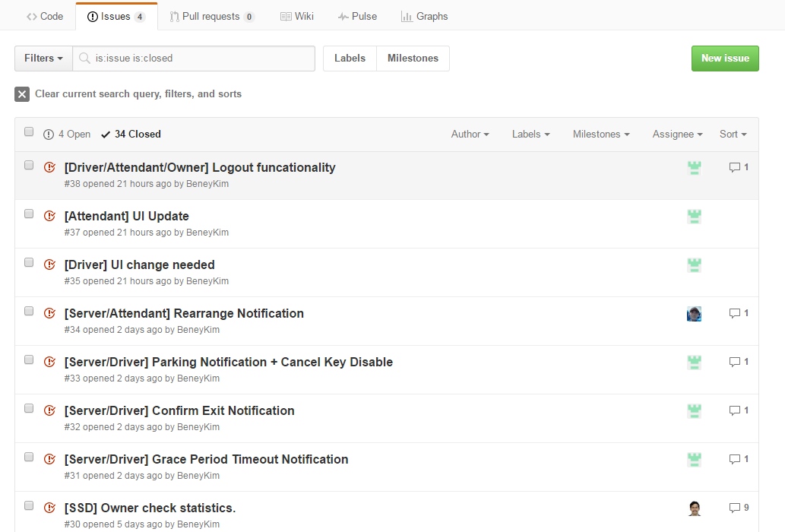
Issue tracking system
We used github issue for issue tracking

Slide 28
Lessons learned
Organization perspective
Didn’t assign each one’s responsibility concretely ➔ too much discussion, but no decisions made
Technology perspective
Obsessed with technologies prior to decision-making about the architecture
Architecture perspective
Too focused on dynamic perspective
Hard to have consistent views across static, dynamic, and physical perspectives
Are we architects now ?
not yet, Not Yet, and NOT YET

Slide 29

Please don’t ask me anything
I just want to go home…
Any questions ?

